Slide 1
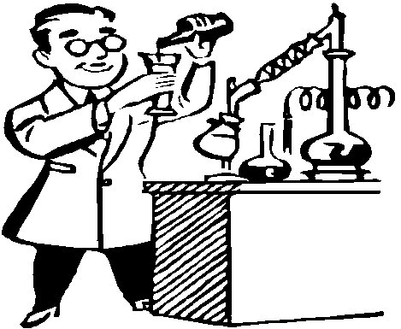
Chemical Reactions And
Equations
Notes:
Chemical Reaction - Study Questions
1. What is a chemical reaction?
2. What is evidence a reaction has occurred?
3. What is a chemical equation?
4. Define reactants.
5. Define products.
6. Define catalyst.
7. What information is found in an equation?
8. What symbols are used to represent the states of matter?
9. What is the meaning of “aq”?
10. How do you indicate a catalyst is being used in a reaction?
11. What is activation energy?
12. What the three things does conservation of matter require of chemical equations?
13. What is the procedure for balancing a chemical equation?
14. Balance the equation for the reaction of magnesium chloride and silver nitrate to form magnesium nitrate and silver chloride.
15. What is a synthesis reaction?
16. How is a combustion reaction related to a synthesis reaction?
17. What type of reaction is an explosion?
18. Compare decomposition and dissociation.
19. What determines whether one metal will replace another in a single displacement reaction?
20. What is the general form of a double displacement reaction?
21. What type of reaction is each of these?
2Na(s) + Cl₂(g) → 2NaCl(s)
PCl₅(s) → PCl₃(s) + Cl₂(g)
2Al(s) + Fe₂O₃(s) → 2Fe(s) + Al₂O₃(s)
C₆H₁₂O₆(s) + 6O₂(g) → 6CO₂(g) + 6H₂O(l)
BaCl₂(aq) + H₂SO₄(aq) → 2HCl(aq) + BaSO₄(s)
22. What is the oxidation number of an element?
23. What is the oxidation number of the fluorine ion?
24. What is the sum of the oxidation numbers in a compound?
31. Can a redox reaction form a molecule? Explain your answer.

Slide 2
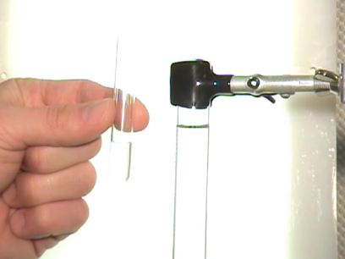
CHEMICAL REACTIONS
Chemical Reactions are associated with chemical change.
Whenever a chemical change occurs chemical reaction is said to take place
Chemical reactions are usually irreversible and a new product is formed.
During a chemical Reaction old chemical bonds are broken and new chemical bonds are formed which lead to the formation of new products

Slide 3
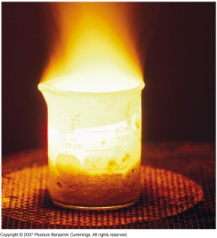
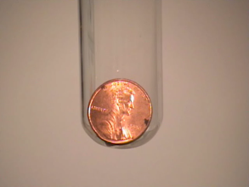
Signs of Chemical Reactions
There are five main signs that indicate a chemical reaction has taken place:
change in color
Evolution of a gas
Change in temperature
Change in state

Slide 4
Word Equations
A WORD EQUATION describes chemical change using the names of the reactants and products.
Write the word equation for the reaction of methane gas with oxygen gas to form carbon dioxide and water.
methane + oxygen
carbon dioxide + water
Reactant
Product
CH₄
+
2
O₂
CO₂
+
2
H₂O

Slide 5
CHEMICAL EQUATIONS
The simplest form of description of a chemical reaction in a shorter form is by writing it in the form of an equation. E.g.-
Mg + O₂ MgO
It a representation of a chemical change by the help of symbols of elements and formulae of compounds
The reactants are written on the left side and product is written on the right side.
An arrow is placed between them to show the direction of reaction.

Slide 6
Characteristics
Of Chemical Equations
The equation must represent the known facts and feasible chemical change
The equation must contain the correct formulae of the reactants and products.
The important conditions of temperature, pressure and catalysts during the reaction must be written on the top of the chemical equation
The law of conservation of mass must be satisfied.

Slide 7
Showing Phases in a Chemical Equation
H₂O(s) H₂O(l) H₂O(g)
Solid Phase – the substance is relatively rigid and has a definite volume and shape. NaCl(s)
Liquid Phase – the substance has a definite volume, but is able to change shape by flowing. H₂O(l)
Gaseous Phase – the substance has no definite volume or shape, and it shows little response to gravity. Cl₂(g)

Slide 8
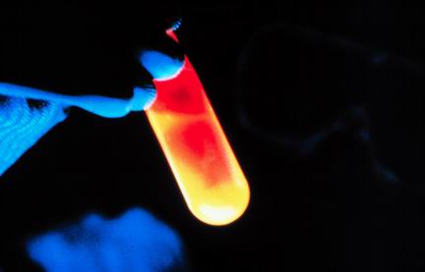
Balanced Chemical Equations
Chemical equations are of two types- Skeleton Equation and Balanced Chemical Equation.
According to the law of conservation of mass, total mass must be equal on the both sides of the equation.
This type of equation is known as a balanced chemical reaction. E.g.-
2Mg + O₂ 2MgO
Here both sides have two atoms of Magnesium and two atoms of Oxygen. Hence the equation is balanced
Notes:
A chemical equation is an expression that gives the identities and quantities of the substances in a chemical reaction
Chemical formulas and other symbols are used to indicate the starting material(s) or reactant(s), which are written on the left side of the equation, and the final compound(s) or product(s), which are written on the right side. An arrow, read as yields or reacts to form, points from the reactants to the products.
Abbreviations are added in parentheses as subscripts to indicate the physical state of each species:—(s) for solid, (l) for liquid, (g) for gas, and (aq) for an aqueous solution.
A balanced chemical equation is when both the numbers of each type of atom and the total charge are the same on both sides. A chemical reaction represents a change in the distribution of atoms but not in the number of atoms.
http://img.alibaba.com/photo/10784694/Aluminum_Oxide_Abrasive_Fine_Grit_120_220_.jpg
http://upload.wikimedia.org/wikipedia/commons/thumb/f/f2/Corundum_Aluminum_Oxide_Gallantin_Co_MontanaDSC03201.jpg/600px-Corundum_Aluminum_Oxide_Gallantin_Co_MontanaDSC03201.jpg
http://www.germes-online.com/direct/dbimage/50327532/Aluminum_Alloy_Pipe.jpg

Slide 9
Unbalanced and Balanced Equations
H
Cl
Cl
Cl
H
H
H
Cl
Cl
Cl
Cl
H
H
H
H₂ + Cl₂ → HCl
(unbalanced)
H₂ + Cl₂ → 2 HCl
(balanced)
reactants products
reactants products
H
2
1
H
2
2
Cl
2
1
Cl
2
2

Slide 10
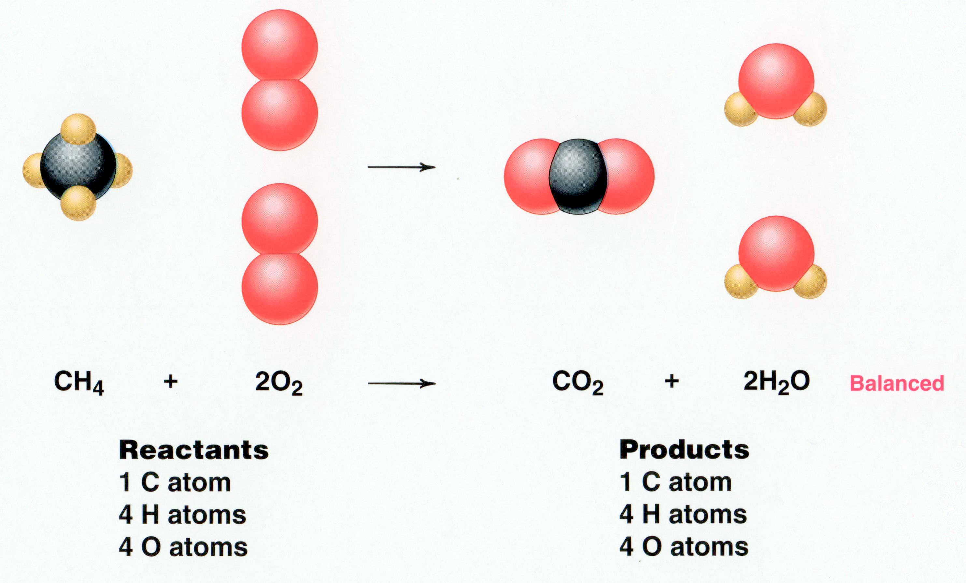
CH₄ + 2 O₂ → CO₂ + 2 H₂O
Reactants Products
1 C atom 1 C atom
4 H atoms 4 H atoms
4 O atoms 4 O atoms

Slide 11
Visualizing a Chemical Reaction
2
2
Na + Cl₂ NaCl
10
5
10
10
10
5
?
___ mole Na
___ mole Cl₂
___ mole NaCl

Slide 12
Types of Chemical Reactions
1. Combination reaction
A + B → AB
2. Decomposition reaction
AB → A + B
3. Single-displacement reaction
A + BC → AC + B
4. Double-displacement reaction
AB + CD → AD + CB
5. Redox reaction
Notes:
Objective:
To classify a chemical reaction as one of the following types: combination (synthesis), decomposition, single replacement, double replacement, or neutralization.

Slide 13
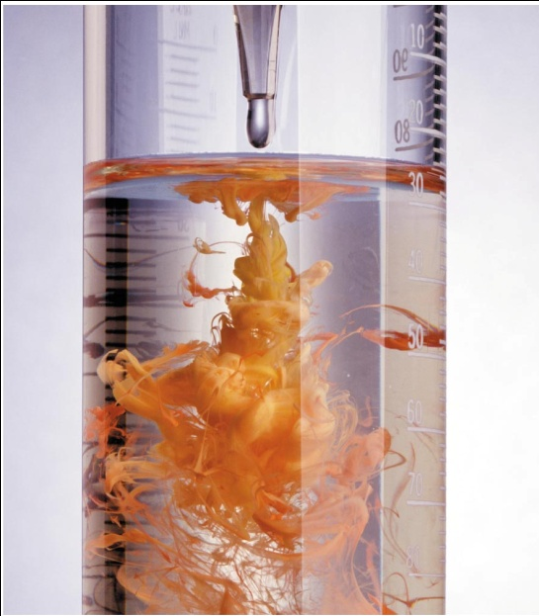
Combination Reactions
The type of reaction in which two reactants combine to form a single product.
E.g. – A + B AB
CaO + H₂O Ca(OH)₂
C + O₂ CO₂
They are generally exothermic reactions which involve evolution of heat during reaction.

Slide 14
Combination Reaction
2 Na + Cl₂ → 2 NaCl
Na
Na
Cl
Cl
→
Cl
Cl
Na
Na
General form: A + B → AB
element or element or compound
compound compound

Slide 15
Decomposition Reaction
The type of reaction in which a single reactant breaks down to give two or more simpler product is called decomposition reaction.
Ex: AB A + B
Decomposition reaction can be carried out by the supplying energy by means of heating, electricity or light. It is known as Thermal decomposition, Electrolytic decomposition and Photodecomposition reactions respectively
2 H₂O
2H₂
+
O₂

Slide 16
Decomposition Reaction
Decomposition reaction
2 H₂O
2 H₂
+
O₂
H
O
H
O
H
H
+
H
O
H
O
H
H
General form: AB
A
+
B
compound
two or more elements
or compounds

Slide 17
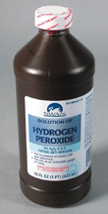
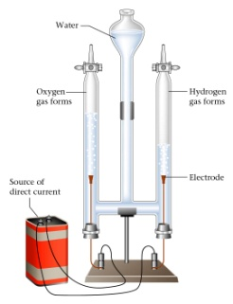
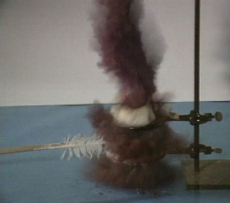
Decomposition Reactions
Hydrogen Peroxide
H₂O₂ H₂O + O₂
2
2
Electrolysis of water
2
electricity
2
H₂O H₂ + O₂
Nitrogen triiodide
2
NI₃ N₂ + I₂
3
General Form
AB A + B

Slide 18
Displacement Reactions
The reaction in which a more reactive element displaces a less reactive element from its salt solution is known as Displacement Reaction.
This is of two types:-
Single Displacement Reaction
Double Displacement Reaction

Slide 19
Single and Double DISplacement Reactions
Single-replacement reaction
Mg + CuSO₄ → MgSO₄ + Cu
General form:
A + BC → AC + B
Double-replacement reaction
CaCO₃ + 2 HCl → CaCl₂ + H₂CO₃
General form:
AB + CD → AD + CB

Slide 20

Single Displacement Reaction
lead (II) chloride + potassium iodide
potassium chloride
+
lead (II) iodide
Pb²⁺
Cl¹⁻
K¹⁺
I¹⁻
Pb²⁺
Cl¹⁻
K¹⁺
I¹⁻
K
Cl₂
I
Pb
+
KCl
+
PbI₂
(aq)
(yellow ppt)
Notes:
A reaction that yields an insoluble product, a precipitate, when two solutions are mixed
Are a subclass of exchange reactions that occur between ionic compounds when one of the products is insoluble
Used to isolate metals that have been extracted from their ores and to recover precious metals for recycling

Slide 21
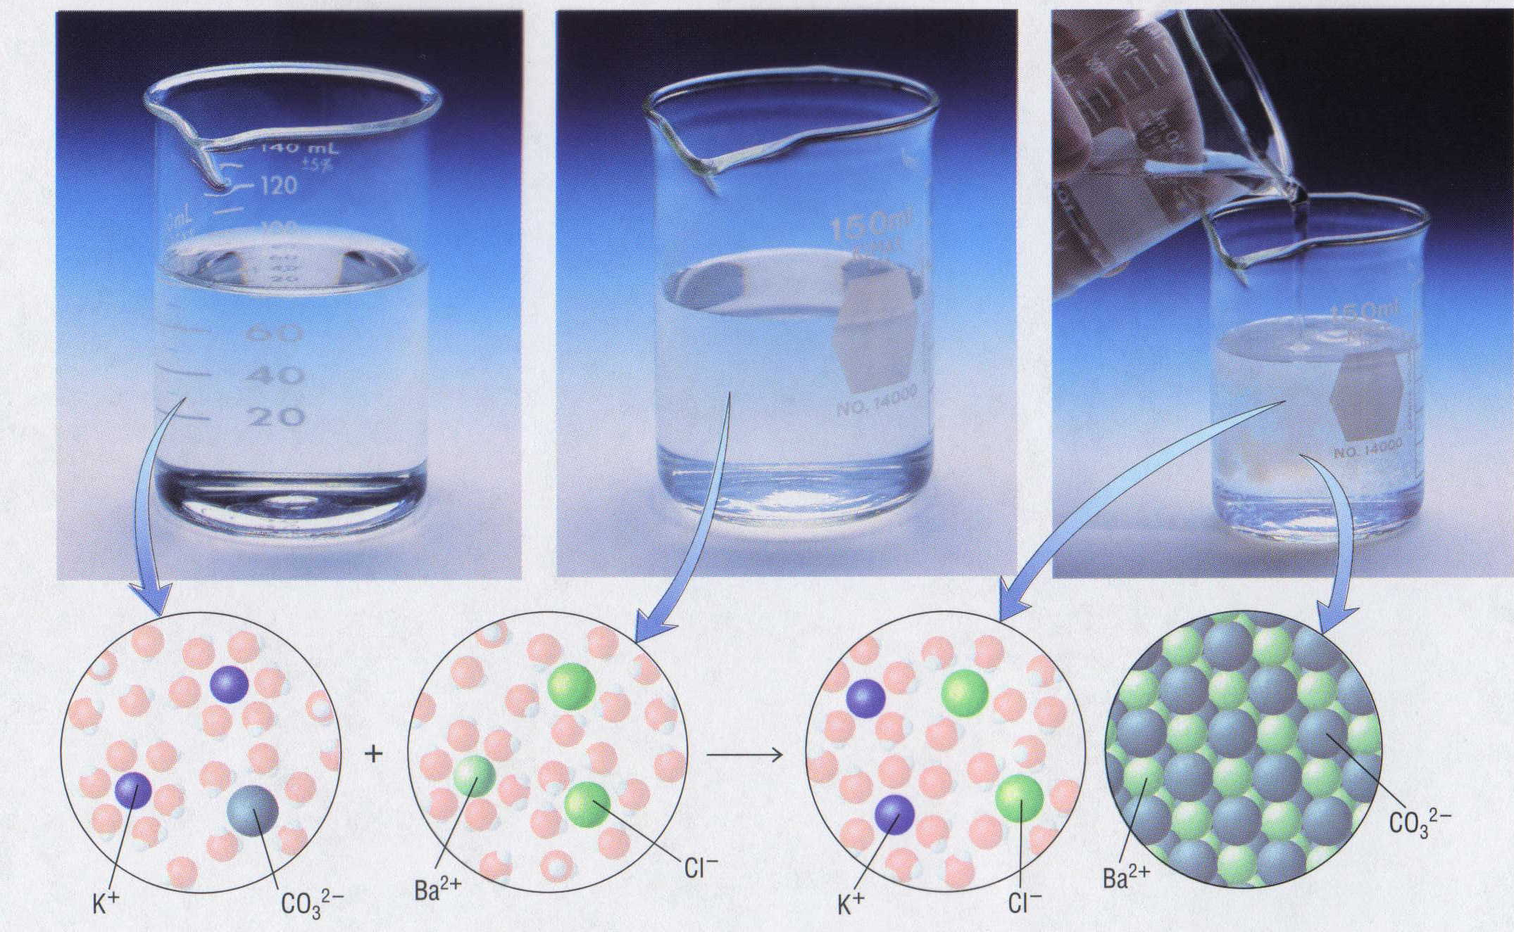
Double Displacement Reaction
K₂CO₃ (aq)
Potassium carbonate
+
BaCl₂ (aq)
Barium chloride
2 KCl (aq)
Potassium chloride
+
BaCO₃ (s)
Barium carbonate

Slide 22
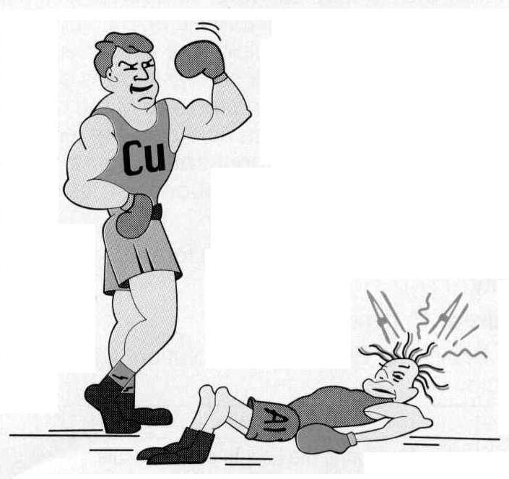
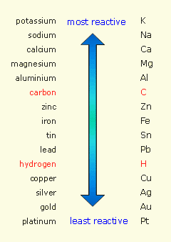
Reactivity Series
Element Reactivity
Foiled again –
Aluminum loses to Calcium
Ca
Notes:
Objectives:
To explain the concept of an activity series for metals.
To predict whether a single-replacement reaction occurs by referring to the activity series.
The Activity Series
– Predicts the outcome of the single-displacement reactions
– Arranges metal and hydrogen in decreasing order of their tendency to be oxidized
– Active metals at the top of the series have the greatest tendency to lose electrons; these including alkali metals (Group 1), alkaline earths (Group 2), and Al (Group 13).
– Inert metals at the bottom of the series have the lowest tendency to be oxidized; these include precious metals or coinage metals located in the lower-right portion of the metals in the periodic table.
– Any element will reduce compounds of the elements below it in the series.
– Only those metals that lie above hydrogen in the activity series dissolve in acids to produce H₂.

Slide 23
Redox Reactions
Redox reactions are those reactions in which both oxidation and reduction takes place simultaneously.
If a substance gains oxygen during a reaction, it is said to be oxidised. If a substance loses oxygen during a reaction, it is said to be reduced
If a substance gains hydrogen during a reaction, it is said to be reduced. If a substance loses hydrogen during a reaction, it is said to be oxidised
Reactions in which this type of change occurs is known as Oxidation and Reduction reactions or Redox reactions. E.g. –
CuO + H₂ Cu +H₂O

Slide 24
Redox Reactions
Oxidising agent are those substances which makes available oxygen or removes hydrogen and helps reaction to take place and facilitates the oxidation process.
Reducing agent are those substances which makes available hydrogen or removes oxygen and helps reaction to take place and facilitates the reduction process.
Both oxidising agent and reducing agent facilitates Redox reaction

Slide 25
Oxidation and Reduction Reactions in our daily lives….
There are a number of redox reactions which take place in our daily lives.
1. Corrosion
2. Rancidity
Corrosion is slow process of self oxidation in which a metal undergoes layer by layer destruction after reaction with atmospheric oxygen and moisture. Ex- Rusting of iron, tarnishing of silver, Copper turns green when exposed in air.

Slide 26
Rancidity.
Rancidity is a slow process of self atmospheric oxidation of food containing fats and oils marked with unpleasant smell and taste. Ex- Butter turns rancid
Ways to reduce rancity…
1. Storing food in air tight container
2. Storing food low temperature
3. Storing food dark containers to stop reactions by the help of sunlight
4. Use of antioxidants such as BHT ( Butylated Hydroxy Toluene) and BHA (Butylated Hydroxy anisole)

Slide 27
Any Questions…
THANK YOU
BY: RAKESH KUMAR

